Slide 1

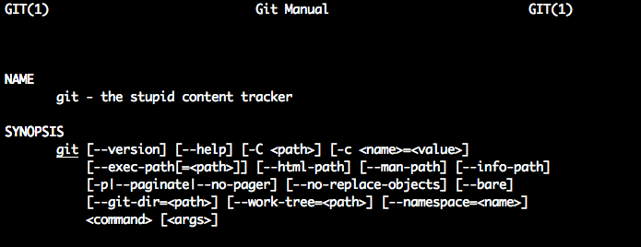
Dive into
Jan Van Uytven

Slide 2
Outline
What is Git?
Overview of Git's Architecture
Git Common Tasks
Git Remotes
Git Workflow
Tips and Tricks
Further Topics to Explore

Slide 3
A Brief History of Git
Up until 2005, The Linux Project was hosted using the proprietary BitKeeper DVCS.
In March, Larry McVoy (BitKeeper author) revoked the free BitKeeper license granted to the Linux Team, accusing Andrew Tridgell (a kernel developer) of reverse-engineering the BitKeeper protocols.
Linus Torvalds & co began evaluating open-source alternatives (SVN, Monotone)

Slide 4
A Brief History of Git
Requirements:
Had to be a DVCS, like BitKeeper
Handle thousands of developers
Fast and efficient, with a clean object model
Maintain internal integrity
Enforce accountability
Immutable objects, but not immutable history
Atomic transactions
Branching needs to be fast and easy
A repositories should be complete.
Free, as in beer.
Linus Torvalds & co had a list of requirements for the new SCM.
None of the existing open-source SCMs fulfilled the requirements.
Linux realized he would need to create one from scratch.

Slide 5
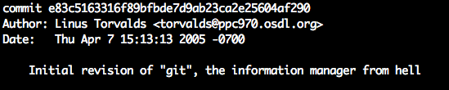
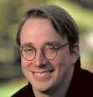
A Brief History of Git
Development began on April 3rd
Git became self-hosting on April 7th

Slide 6
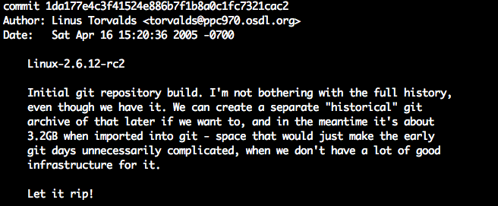
A Brief History of Git
Development began on April 3rd
Git became self-hosting on April 7th
First commit of Linux kernel into git
happened on April 16th

Slide 7
A Brief History of Git
Development began on April 3rd
Git became self-hosting on April 7th
First commit of Linux kernel into git
happened on April 16th
< 2 weeks from start to finish

Slide 8
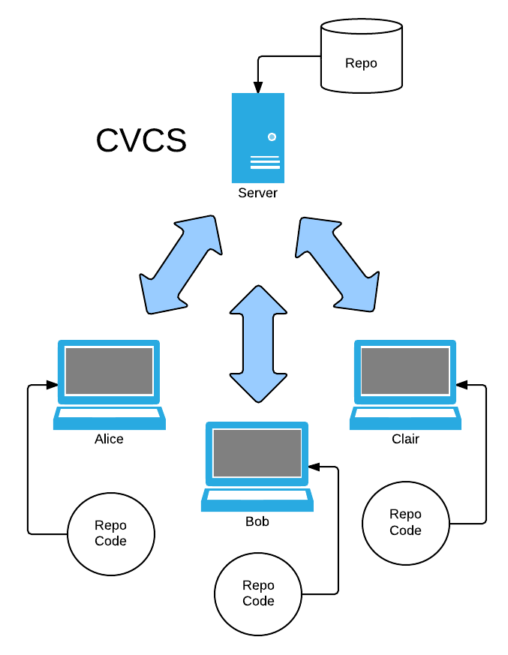
What is a DVCS?
In a centralized version control
system, the change history is
stored in a central location, and
everyone retrieves and contributes
code to and from this one source.
People can have the whole codebase,
or a portion of it.
The distinction between client (the
developer) and server (the repo) is
clear.

Slide 9
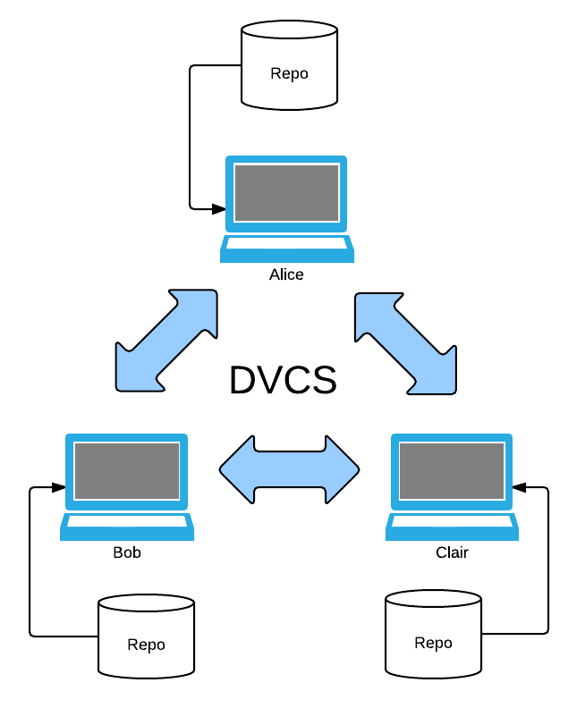
What is a DVCS?
With a distributed version control
system, everyone gets a copy of the
repo, and changes can be propagated
from any user to any other user, subject
to any security constraints.
Each user acts as an ad-hoc server,
therefore, no centralized server
is required.
However...

Slide 10
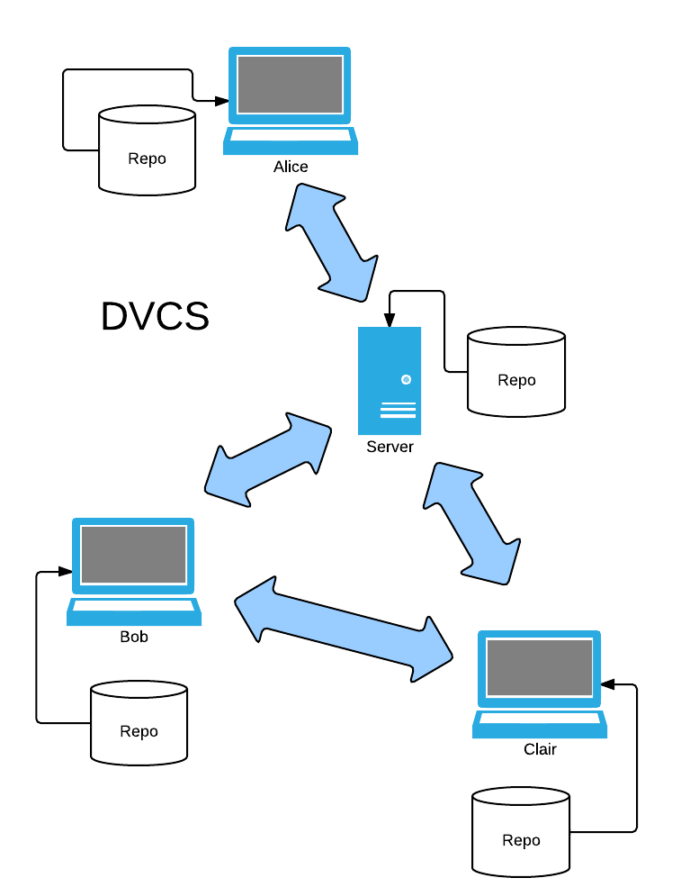
What is a DVCS?
In practice, there is almost always a
'central' or 'authoritative' server.
However this is through consensus, and the 'central' server has no special attributes.
Any repo can be declared as the new 'authoritative' source as needed.
Change can still flow between other repos if desired.

Slide 11
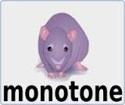


What is a DVCS?
DVCSs have exploded in popularity recently. Why?
Disconnected operation – work anywhere,
anytime
Experimental branching – creating and
destroying branches is easy
Ad-hoc collaboration with peers
DVCS stays out of the way

Slide 12
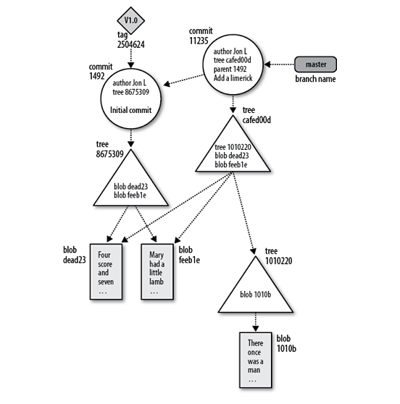
Git Architecture

Slide 13
Let's Talk About Hashes

Slide 14
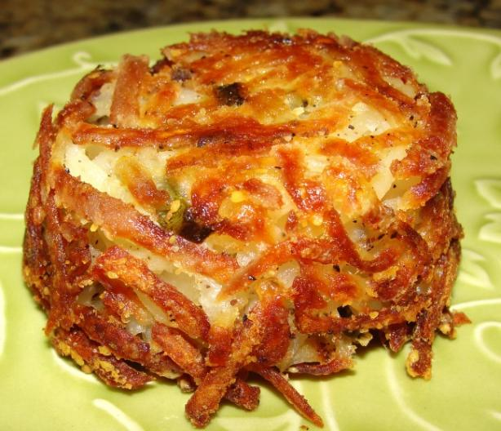
Let's Talk About Hashes

Slide 15

Let's Talk About Hashes
Git uses the SHA-1 hash to identify almost everything it stores
SHA-1 is a hashing algorithm that produces the same
40-character hexadecimal string for any distinct piece of content
Chance of collision: one in 2^80 blobs
Example:
$ git hash-object troll.png
ac9b69eebf06207e8478f5a308364cb6cb98899a

Slide 16
Let's Talk About Hashes
In Git, it is not necessary to specify the full hash, as long as
Git can unambiguously identify what you mean.
The minimum length is 4 characters.
You can use git rev-parse to figure out the full hash, if needed.
For example, the following are all equivalent:
$ git show ed0e6e213cdf11330c194530f80d19545dab4842cv
$ git show ed0e6e21
$ git show ed0e

Slide 17
Four Types of Objects
Blobs – binary objects stored in the object store.
They can contain other objects, such as trees and
commits.
blob
e4f6

Slide 18
Four Types of Objects
Blobs – binary objects stored in the object store.
They can contain other objects, such as trees and
commits.
Trees – simple structures that represent a single
directory layer
blob
e4f6
tree
ca5d

Slide 19
Four Types of Objects
Blobs – binary objects stored in the object store.
They can contain other objects, such as trees and
commits.
Trees – simple structures that represent a single
directory layer
Commits – points to a single tree and potentially
one or more parent commits
blob
e4f6
tree
ca5d
Author:
Juytven
...
commit
b24f

Slide 20
Four Types of Objects
Blobs – binary objects stored in the object store.
They can contain other objects, such as trees and
commits.
Trees – simple structures that represent a single
directory layer
Commits – points to a single tree and potentially
one or more parent commits
Refs – tags that point to a particular commit, or
to other refs (the latter are called symbolic refs)
blob
e4f6
tree
ca5d
Author:
Juytven
...
commit
b24f
master

Slide 21
Blobs
All repository data, excluding the index, references and a few special
pieces of metadata, are stored as blobs in git's object store (.git/objects)
The blobs are named by the SHA-1 hash of their content.*
The object store has a flat namespace, broken up by the first two
characters of the object's SHA-1 hash. For example, the hash
64c0dbc6305b775c3031f6ba221303c36416dfba
is stored as
64/c0dbc6305b775c3031f6ba221303c36416dfba
This divides the object store into 256 directories, which helps avoid
filesystem problems and helps the performance of calls such as readdir().
* Well, their content prepended with 'blob <n>' where n is the file length.
This is done so git can store 0-byte entities, like empty files.

Slide 22
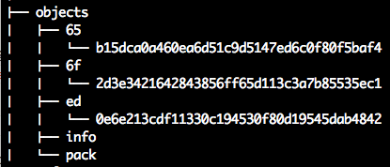
Blobs
You can examine the contents of any blob
with git cat-file -p <sha1>
Blobs do not contain any metadata or
structure – only the contents of the object
they store. Not even the filename!
Because every object with the same contents will hash to the same blob,
it's possible to aggregate object stores across repositories.
This is a crucial distinction – Only content matters to Git. If a file changes,
then it is stored as a separate object. No relation is stored, Git does not
care that the new object shares the same filename as the previous revision
or has content that is very similar to the previous revision – it is still stored
as a separate, unrelated object.

Slide 23
Trees
If Git blobs don't know their own names, how are they tracked?
If Git blobs are stored in a flat namespace, how is directory structure stored?

Slide 24
Trees
Git uses tree objects to track a particular directory level.
Each tree lists the blobs in that particular directory, and points to additional trees for each sub-directory.
You can use git ls-tree <tree> to list the contents of a particular tree:

Slide 25
Trees
Git uses tree objects to track a particular directory level.
Each tree lists the blobs in that particular directory, and points to additional trees for each sub-directory.
You can use git ls-tree <tree> to list the contents of a particular tree:
foo.txt
bar.txt
baz/kitty.txt

Slide 26
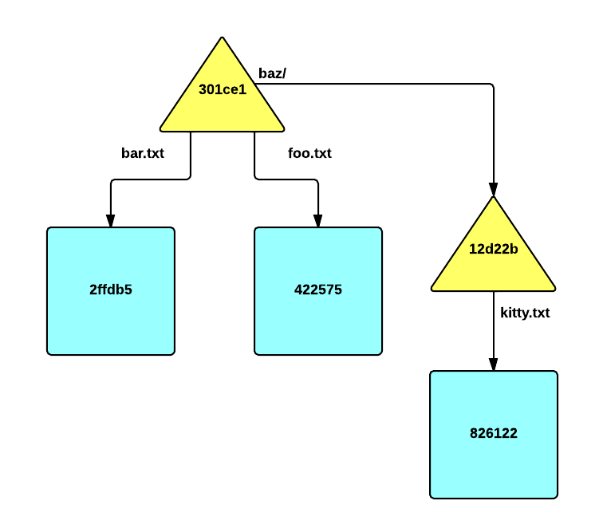
Trees
Git uses tree objects to track a particular directory level.
Each tree lists the blobs in that particular directory, and points to additional trees for each sub-directory.
You can use git ls-tree <tree> to list the contents of a particular tree:
foo.txt
bar.txt
baz/kitty.txt

Slide 27
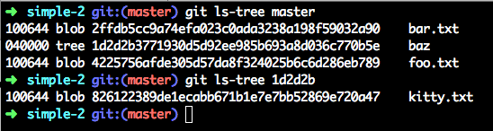
Trees
Git uses tree objects to track a particular directory level.
Each tree lists the blobs in that particular directory, and points to additional trees for each sub-directory.
You can use git ls-tree <tree> to list the contents of a particular tree:
foo.txt
bar.txt
baz/kitty.txt
This works because ls-tree takes a 'tree-ish' object. It's smart enough to realize that master points
to a commit, and the commit, in turn, contains a link to the root tree object for that commit

Slide 28
Commits
So blobs contain the contents of files stored by Git
Trees contain the information to reconstitute a single directory and all the files that directory contains, as well as links to other trees representing subdirectories.
Thus given a root tree(a tree corresponding to the root of the repo) we can retrieve an entire snapshot of a repo.
So how does Git track changes in the repo?

Slide 29
Commits
Git uses commit objects to track units of change
Each commit object is very simple – it consists of the committer (name + email + timestamp), the author (usually the same as the committer), a tree object representing the state of the repo created by that commit, the commit description, and optionally links to one or more parent commits.
As of git 1.7.9, commits can also contain the PGP signature of the committer.

Slide 30
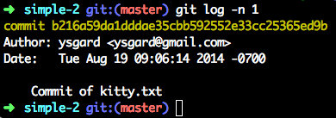
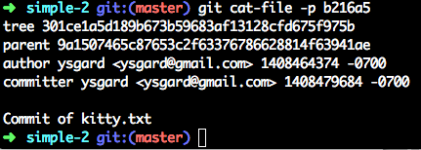
Commits
Git uses commit entities to track units of change
Each commit object is very simple – it consists of the committer (name + email + timestamp), the author (usually the same as the committer), a tree object representing the state of the repo created by that commit, the commit description, and optionally links to one or more parent commits.

Slide 31
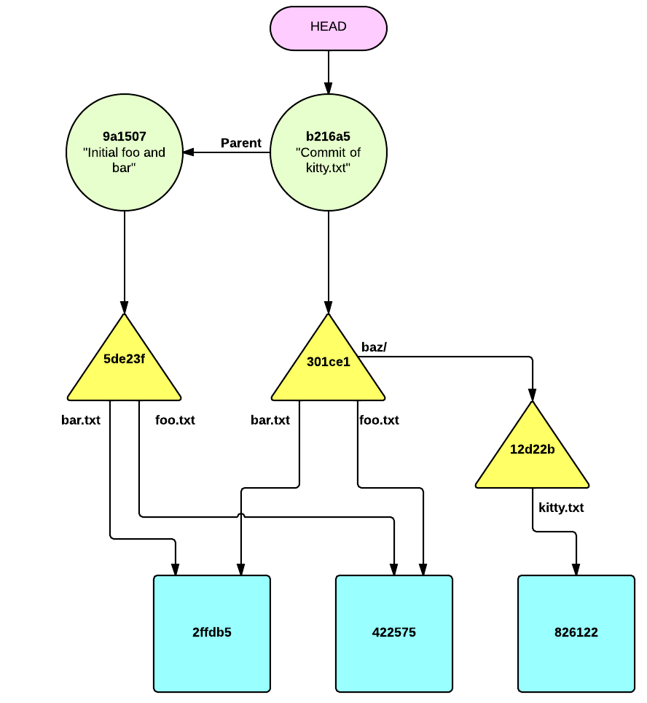
Commits
We can use the tree example from earlier to show how commits relate to trees and blobs.
Each commit points to one tree – the root tree representing the state of the repo after it has been updated with that commit's changes.
Each commit points to its parent(s), except the first commit, which has none.

Slide 32
Commits
With every change committed to the repot, new blobs and trees get created to represent new files and arrangements. If a file or directory hasn't changed, then the old trees and objects are used.
Another example: what happens when we delete foo.txt and rename kitty.txt to bah.txt?

Slide 33
Commits

Slide 34
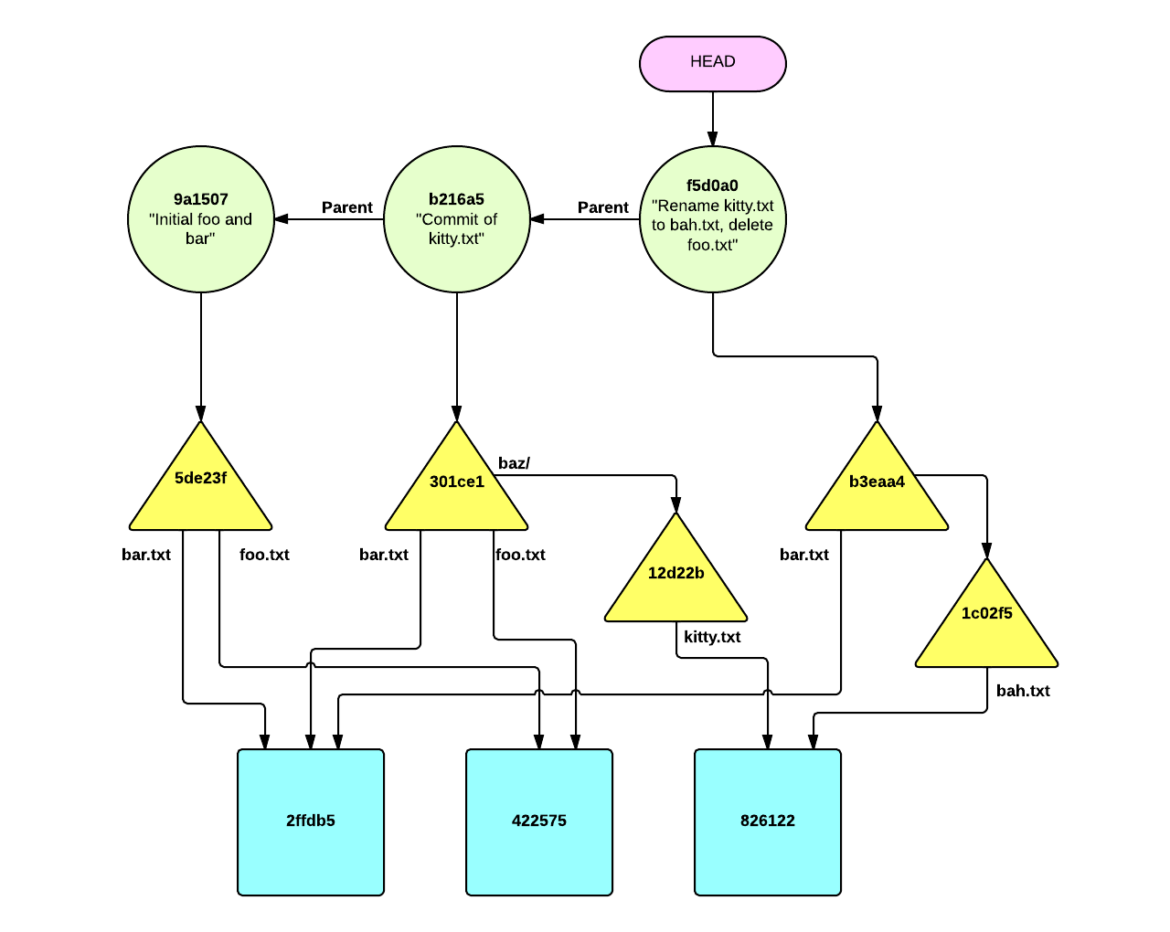
Commits

Slide 35
Commits
So, trees organize blobs and trees into snapshots of the repo
Commits point to these snapshots and record information about that commit, as well as pointing to their parents.
Because trees, and blobs don't change, this means that we can represent the internal organization of git purely in terms of commits (and refs).

Slide 36
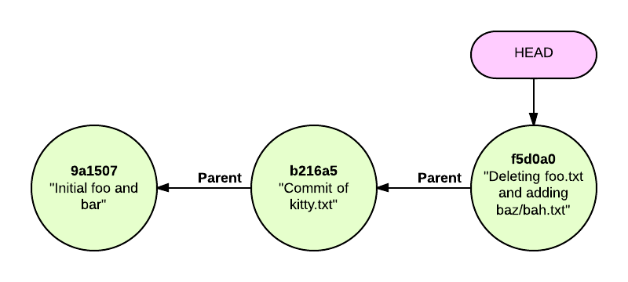
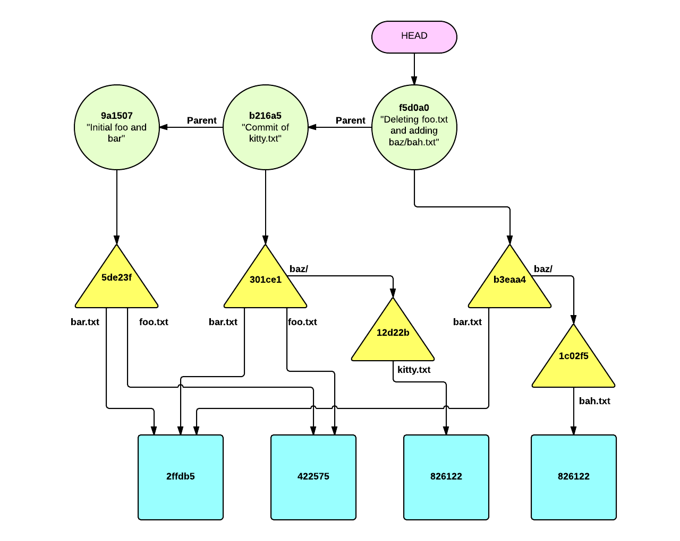
Commits
So, trees organize blobs and trees into snapshots of the repo
Commits point to these snapshots and record information about that commit, as well as pointing to their parents.
This means that we can represent the internal organization of git purely in terms of commits (and refs).

Slide 37
Commits
Each commit doesn't know about
any children – only its parents, of
which it can have none (initial commit),
one (a normal commit) or more (a
merge).

Slide 38
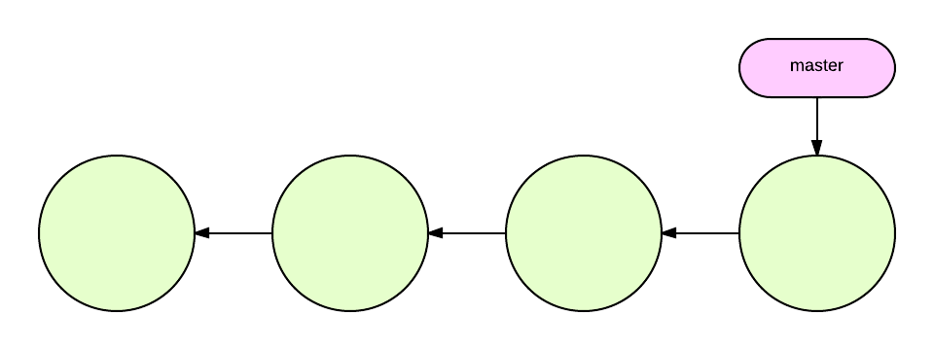
Commits
Each commit doesn't know about
any children – only its parents, of
which it can have none (initial commit),
one (a normal commit) or more (a
merge).
This kind of structure is called a “directed acyclical graph”, and points to the nature of Git's 'history'.

Slide 39
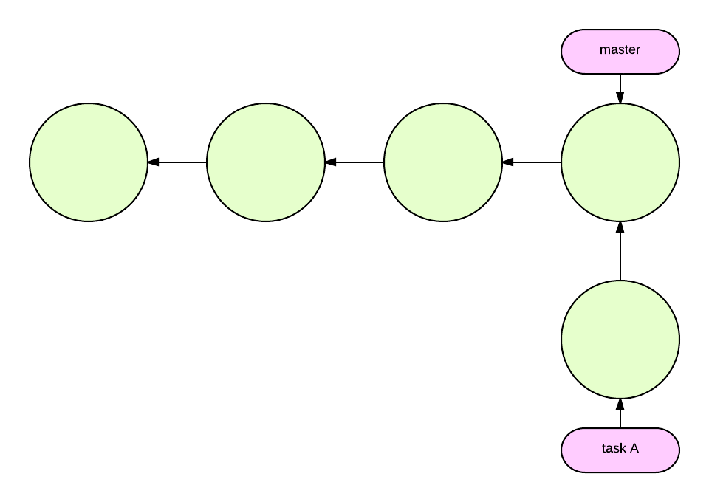
Commits
Each commit doesn't know about
any children – only its parents, of
which it can have none (initial commit),
one (a normal commit) or more (a
merge).
This kind of structure is called a “directed acyclical graph”, and points to the nature of Git's 'history'.
Git doesn't care about time. Timestamps are recorded for reporting purposes only. All Git cares about is what commits have what parents, and which trees the commits point to.

Slide 40
Commits
History in Git is therefore malleable.

Slide 41
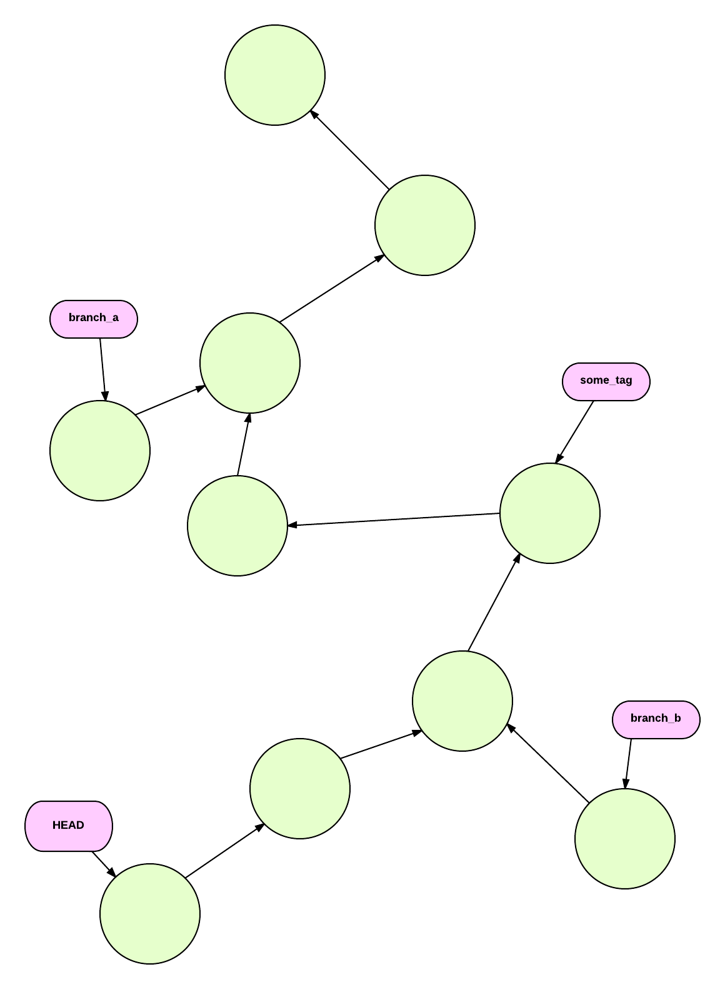
Commits
History in Git is therefore malleable.
Because the history is just a graph,
we can:

Slide 42
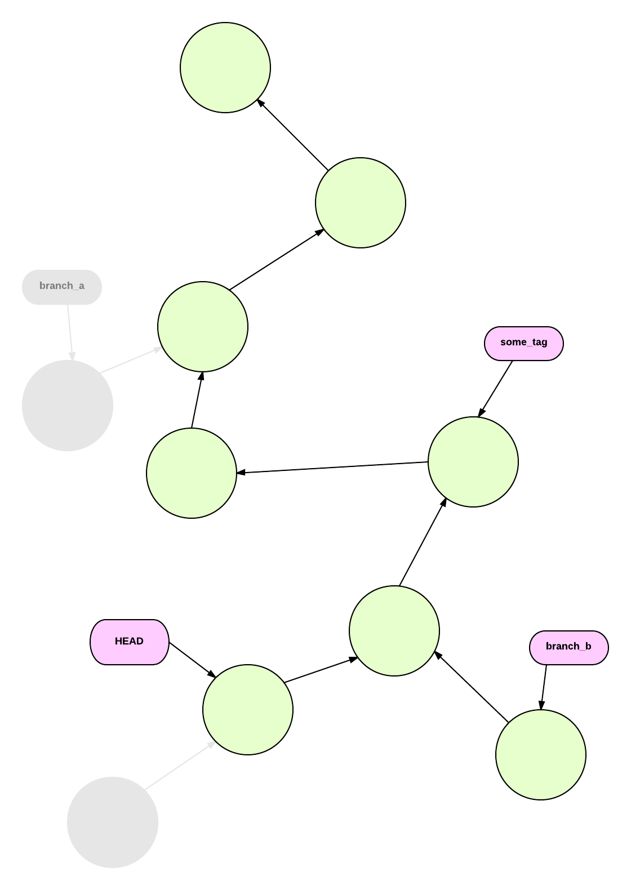
Commits
History in Git is therefore malleable.
Because the history is just a graph,
we can:
Prune the graph (git branch -d,
git reset –hard)

Slide 43
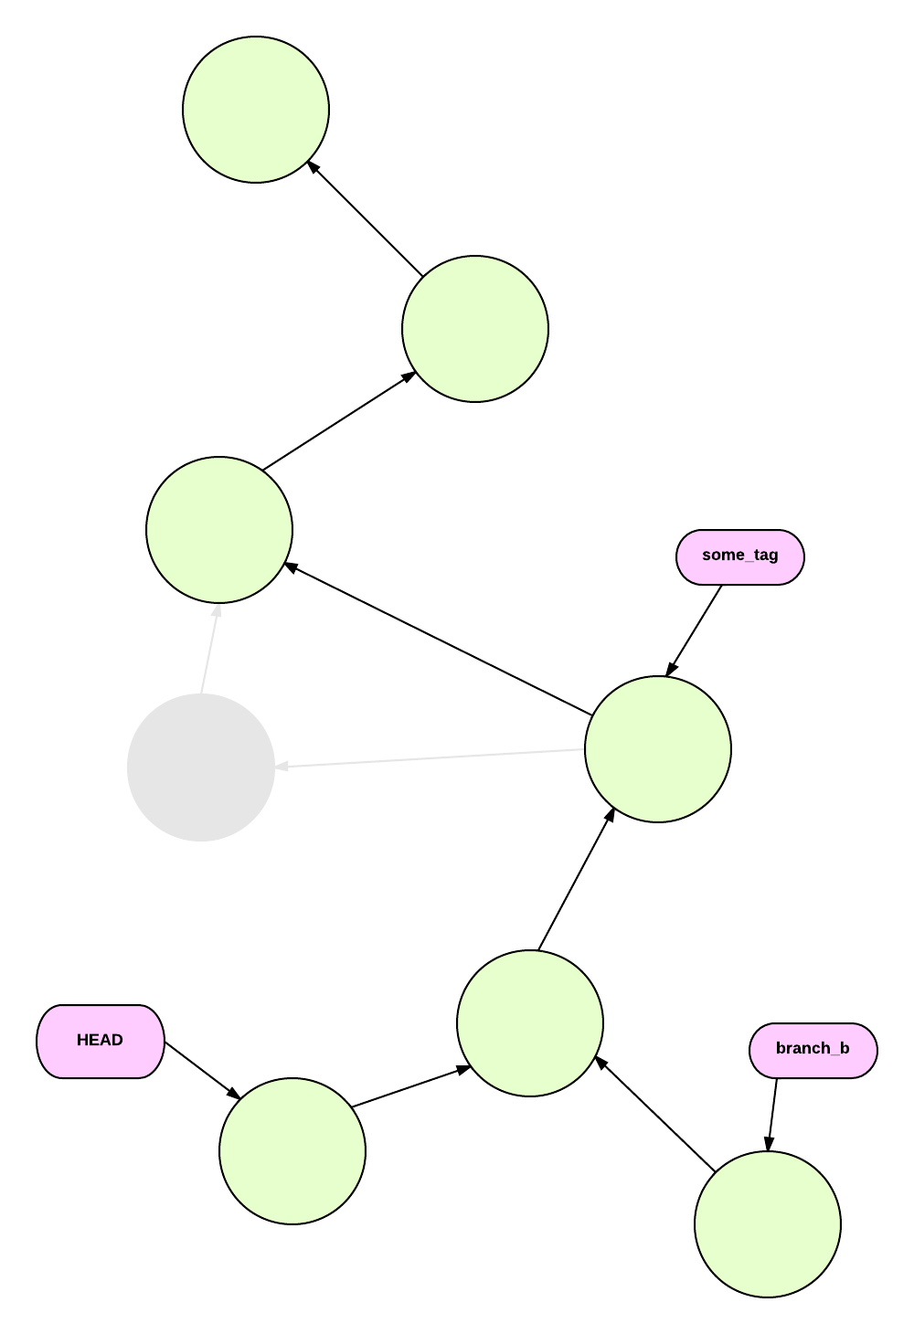
Commits
History in Git is therefore malleable.
Because the history is just a graph,
we can:
Prune the graph (git branch -d,
git reset –hard)
Reorganize the internal nodes
(git rebase, git commit –amend)

Slide 44
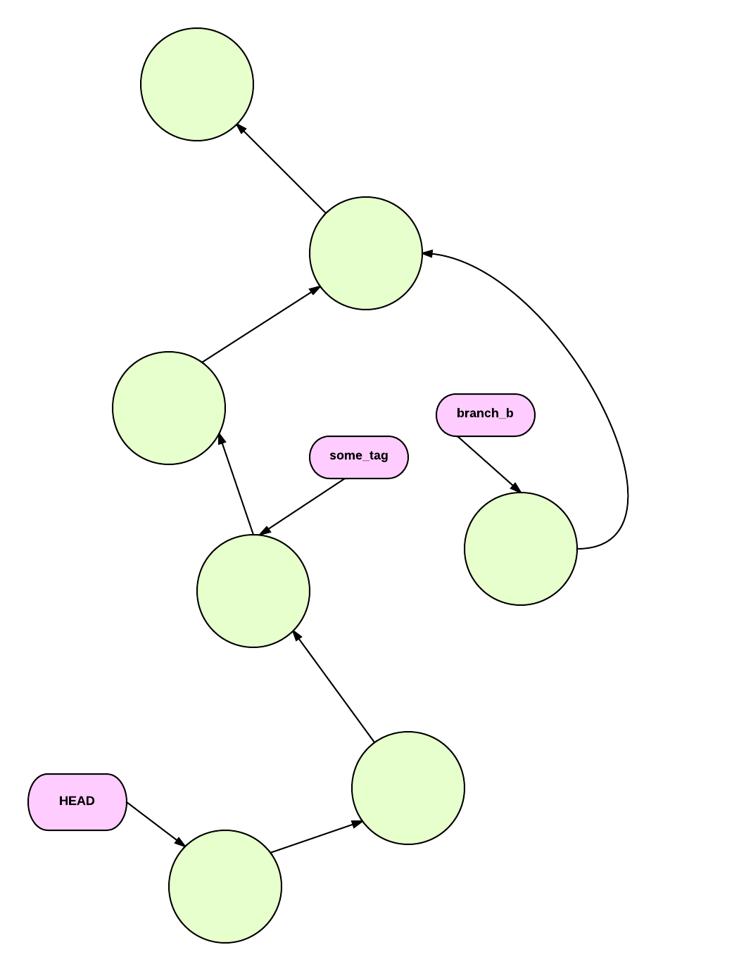
Commits
History in Git is therefore malleable.
Because the history is just a graph,
we can:
Prune the graph (git branch -d,
git reset –hard)
Reorganize the internal nodes
(git rebase, git commit –amend)
Give commits new parents
(git rebase –onto)

Slide 45
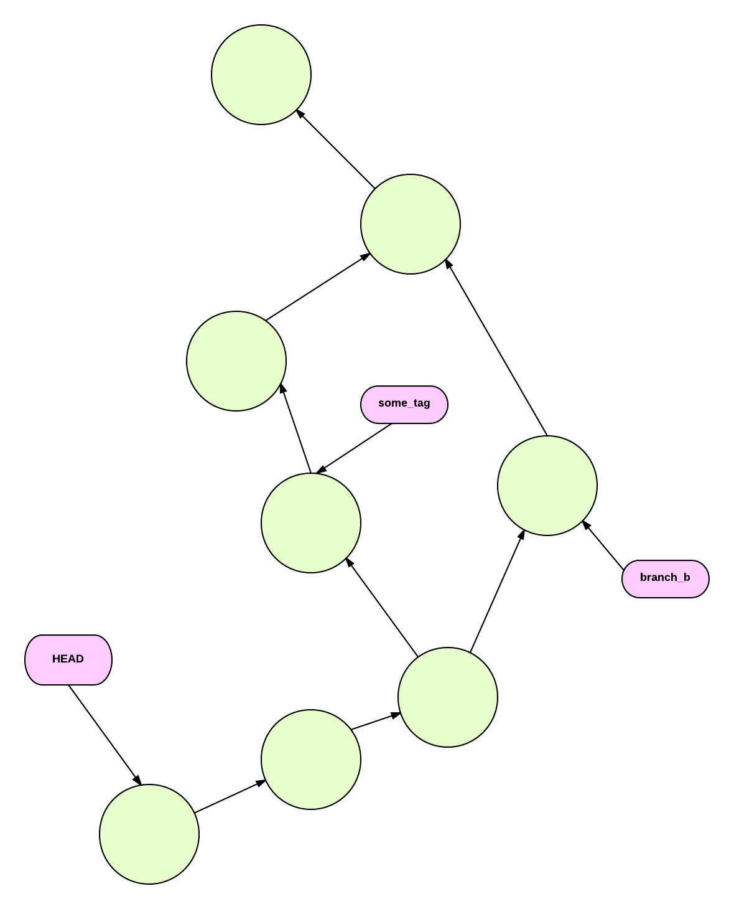
Commits
History in Git is therefore malleable.
Because the history is just a graph,
we can:
Prune the graph (git branch -d,
git reset –hard)
Reorganize the internal nodes
(git rebase, git commit –amend)
Give commits new parents
(git rebase –onto)
Create new commits
(git commit, git merge)

Slide 46
Commits
Manipulating the graph outside of git's normal
workflow (which we'll examine in a bit) isn't
generally recommended except for particular
circumstances, as these internal manipulations
can cause troubles for collaborators.
But Git is flexible and allows you to shoot
yourself in the foot, repeatedly, with a machine
gun if that's what you want.

Slide 47
Commits
“History is the vast and tangled web of conspiracy” -anon

Slide 48

Refs
Refs, in comparison to everything else, are simple.
Refs point to a commit.
Some refs point to other refs. These are called symbolic refs.
Refs are stored in .git/refs

Slide 49
Refs
All branches are refs. 'master' is a ref.
You can use git rev-parse to identify which commit a ref is pointing to:
Git tags are also refs.
The difference between a 'head' ref and a 'tag' ref is that the head ref(which normally points to the last commit on a branch) is advanced with each new commit, whereas a tag ref always points to the same commit.
Git provides some default refs.
HEAD, for example, usually points to the current commit you are on. ORIG_HEAD contains the previous commit that HEAD had before it changed (because of a merge, a rebase, a commit, etc..)
Others include FETCH_HEAD and MERGE_HEAD, which we'll see later.

Slide 50
Refs
Most Git commands will accept a ref instead of a sha-1 hash, which makes them invaluable for navigating a Git repo.
Aside from head refs and tags, there are two other kinds of refs: stash refs, which are used to commit objects that are used to store temporary work, and remote refs, which contain the heads of the branches of any remote repositories tracked by your repo.

Slide 51
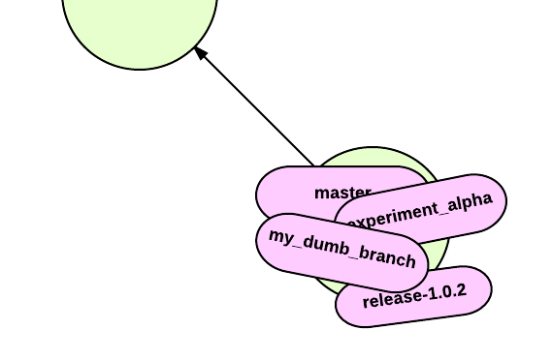
Refs
Even though there are different types, all refs are just labels slapped on commits. The commit it points to may change (head ref), not change (tag ref), be temporary (stash ref) or or obtained from another repo (remote ref), but they are still just labels, and they always point to a commit.
Mmmmf!

Slide 52
Refs
Even though there are different types, all refs are just labels slapped on commits. The commit it points to may change (head ref), not change (tag ref), be temporary (stash ref) or or obtained from another repo (remote ref), but they are still just labels, and they always point to a commit.
Mmmmf!

Slide 53
The Index
Also known as the staging area, because git will refer to files referred to in the index as being staged.
The index allows git users to organize work-in-progress prior to a commit.
Files added to the index are added to the object store, as are any trees to represent their structure. However they are no associated with any commit.
So how does Git track the files in the index? It uses a special, volatile tree object stored in .git/index

Slide 54
The Index
You can see the contents of the index using git status
You can see the actual tree object stored in the index using
git ls-files -s

Slide 55
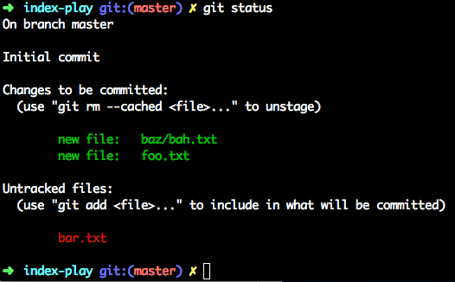

The Index
You can see the contents of the index using git status
You can see the actual tree object stored in the index using
git ls-files -s

Slide 56
The Index
You can use the index to create arrangements of files and directories, and then write the resulting trees into the object store with plumbing commands such as git update-index, git write-tree, git mk-tree and git commit-tree.
This allows to to create arbitrary blobs and trees and link them into existing Git repos, allowing you to insert missing history, repair damaged commits or perform any sort of low-level manipulation.
It is unlikely you will ever need to do this – Git's 'porcelain' commands are more than sufficient to manipulate the Git repo to your heart's content. But the tools are there if you need them.

Slide 57
Git Common Tasks
Init, config, add, commit, rm, mv, status, log, branch, checkout, reset, merge, rebase and tag

Slide 58

First-time Setup
Before you can start using Git, you need to perform some first-time setup
At minimum, Git wants to know your name and your email address

Slide 59
git config

Slide 60
How to use this template
Don’t forget to delete this slide when you’re done.
This template should be used for ALL internal and external Perforce presentations.
Simply click in the placeholders on each slide to enter text or images. Placeholders can be moved depending on slide needs.
To add a new slide that has the same placeholders as the previous slide simply select that slide, then select Insert>New Slide.
There are 9 slide layouts provided:
Title Slide
Title Slide with blue background
About Perforce Software
Title & Content with bullets
Title & Content with animated bottom box*
Title & Content with 3 animated right boxes* and an option to add images
Title & Content Alternate option without bullets
Title Only
Blank
* Slides in from left to right.

Slide 63










Perforce Software
Headquartered in Alameda, California, international operations in the United Kingdom, Canada and Australia.
Trusted with storing and versioning the most valuable IP for the world's most innovative companies
  Over 10,000 customers worldwide
  From start-ups to Fortune 100
  The leading cloud companies

Slide 64
Commit References and Ranges
It's possible to specify commits relative to other commits or refs
They are useful for creating commit ranges, or when using a command where you want to specify a commit relative to the one you are on.
Use <ref>~ to specify the commit's parent.
Use <ref>~<n> to specify the nth parent of the ref.
You can also use <ref>~~ to specify the parent of the parent, etc..

Slide 67
Add Text Here. This box is animated. It slides in from left to right.

Slide 68
Add Text Here.
These boxes are animated.
Slides from left to right.

Slide 71
Are you all done with your presentation? Are you stuck on some slides?
Don’t forget to preview in Presentation mode.
Email graphics@perforce.com for some help from the Gs. We will look it over and make sure your presentation looks good.
Don’t forget to delete this slide when you’re done.

